Slide 1
IPC Accessories Installation Guide
2023-11-08

Slide 2


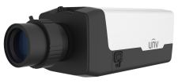

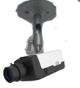
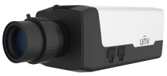
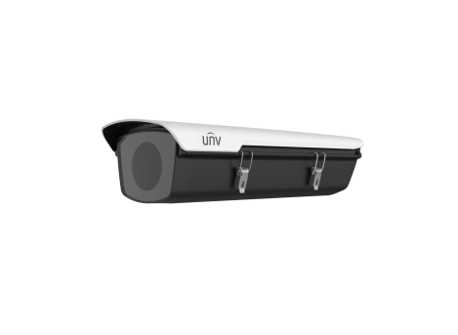
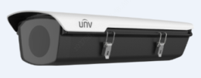
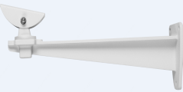

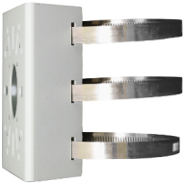
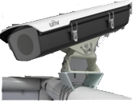
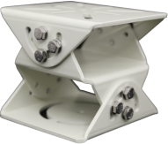

Box camera mount
Indoor Wall mount
Indoor installation:
Pendent mount
TR-WM06-C-IN
IPC54X/IPC56X series
TR-UM06-A-IN
Outdoor installation (-20 ℃~60 ℃)
HS-217S-B-NB
TR-WM06-I-IN
Wall mount
Outdoor installation (-40 ℃~70 ℃)
HS-217SHB-B-NB
Outdoor installation (-40 ℃~70 ℃)
HS-217SHB-IR-B-NB
TR-UV06-A-IN
Horizontal Pole mount
TR-UP06-IN Pole mount

Slide 3
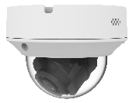
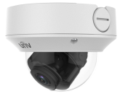
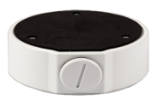

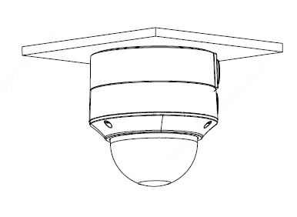


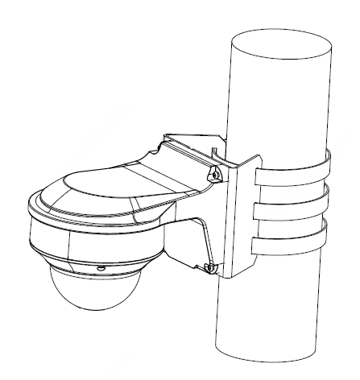
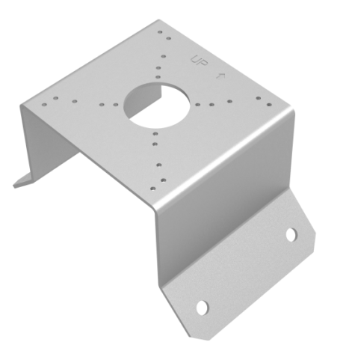
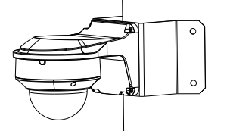

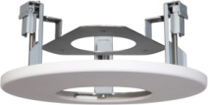
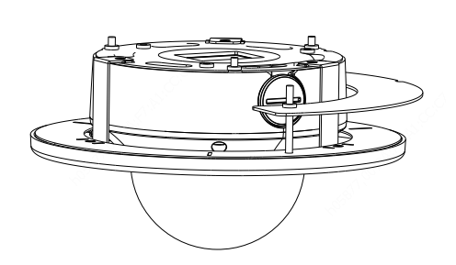
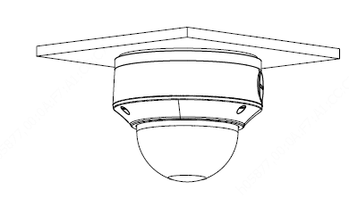
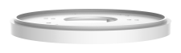
Dome camera mount
NPT ¾”Plastic
Waterproof joint
Junction box
Optional
IPC323X series
TR-JB04-C-IN
TR-A01-IN
Wall mount
(Junction box)
TR-JB07/WM04-B-IN
Pole mount
TR-UP06-IN
Wall mount
TR-WM04-IN
Corner mount
TR-UC08-C
In-ceiling mount
TR-FM152-A-IN
Electric-box Transfer plate
TR-SM04-IN
(US NEMA-WD6 Standard)
Notes:
2018-11-15update：
藏线盒后走线孔向内增加NPS3/4管螺纹，支持安装旋塞，解决亚太客户反馈藏线盒防水问题；
涉及以下型号变更：
1、TR-JB04-C-IN 替代 TR-JB04-IN；计划时间：2018-12，
2、TR-JB07/WM04-B-IN 替代 TR-JB07/WM04-A-IN和TR-JB07/WM04-IN；计划时间：2018-12
3、吊装方案：TR-JB04-C-IN +TR-CM24-IN（新开模具） 替代 TR-UF45-E-IN + TR-CE45-IN；计划时间：2019Q1

Slide 4
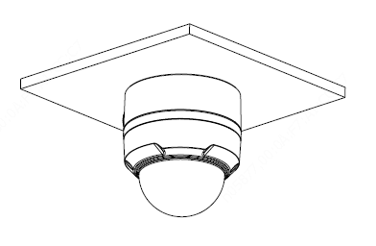
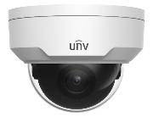
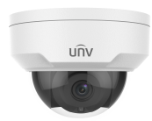

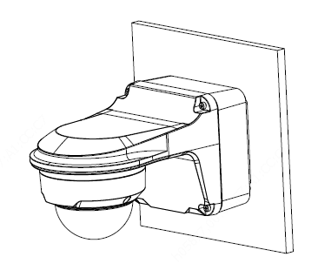
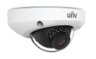
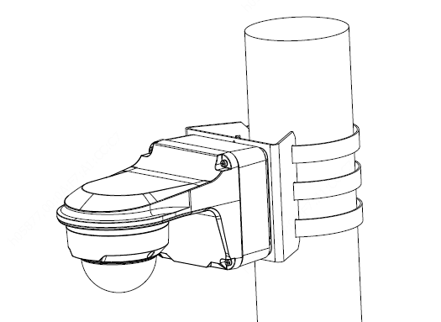
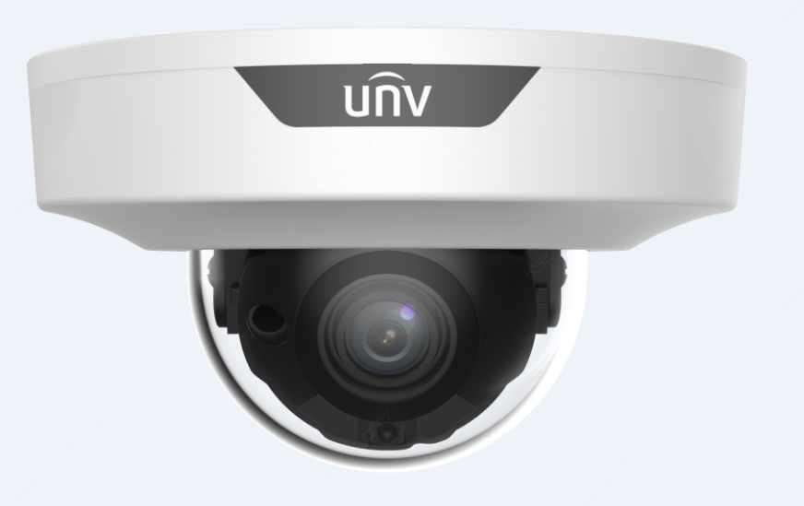


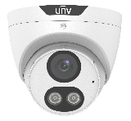
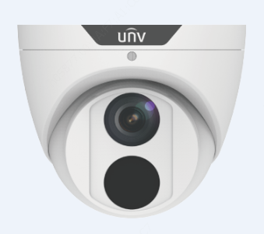
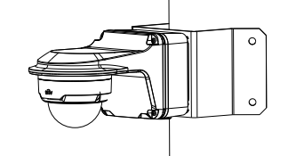

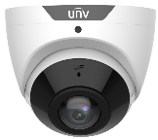
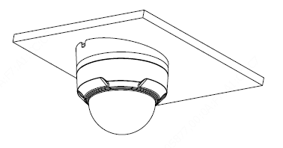
Dome camera mount
NPT ¾”Plastic
Waterproof joint
Junction box
Optional
IPC32X SS\SB\LB\LE series
IPC32X S/E/L series
TR-JB03-G-IN
TR-A01-IN
Wall mount
(Junction box)
TR-JB07/WM03-G-IN
IPC31X
Pole mount
PRIME series
IPC354SR3
Wall mount
TR-UP06-IN
TR-WM03-D-IN
Corner mount
Tilted mounting
TR-UC08-C
IPC361X SE series
IPC3616\361X SS \361XSB series
TR-UM06-E-IN
IPC360X SB series
Notes:
2018-11-15update：
藏线盒后走线孔向内增加NPS3/4管螺纹，支持安装旋塞，解决亚太客户反馈藏线盒防水问题；
壁装支架减小半径，解决北美及欧洲客户反馈段差缝隙问题；
涉及以下款型：
1、TR-JB03-G-IN 替代 TR-JB03-D-IN，计划时间：2018-12
2、TR-JB07/WM03-G-IN 替代 TR-JB07/WM03-E-IN和TR-JB07/WM03-C-IN，计划时间：2019Q1
3、TR-WM03-D-IN 替代 TR-WM03-C-IN，计划时间：2019Q1
4、吊装方案：TR-JB04-G-IN +TR-CM24-IN（新开模具） 替代 TR-UF45-J-IN+TR-CE45-IN；计划时间：2019Q1
2018-8update:
壁装支架外围孔位白漆填补，紧急解决欧洲客户壁装支架缝隙问题
新增TR-JB07/WM03-E-IN和TR-WM03-C-IN（已完成）

Slide 5
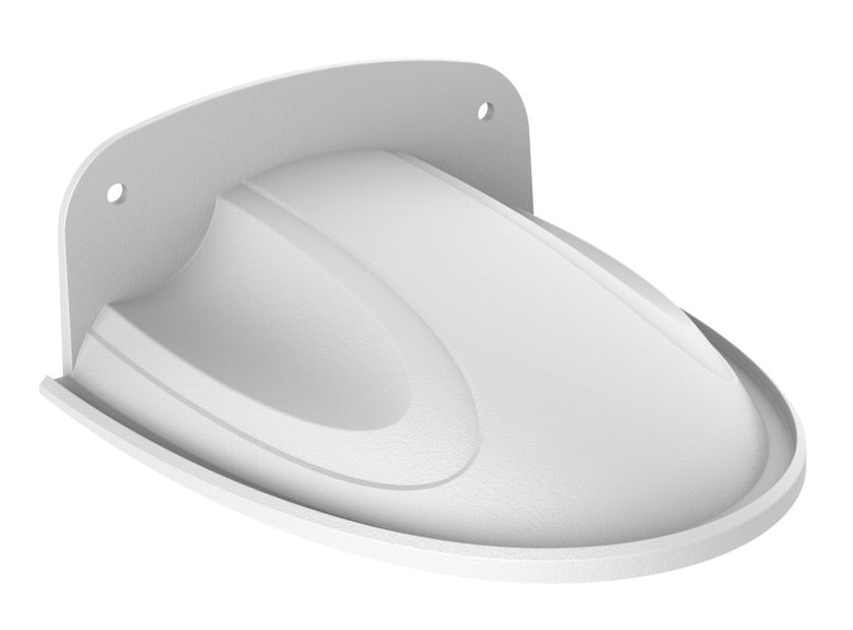
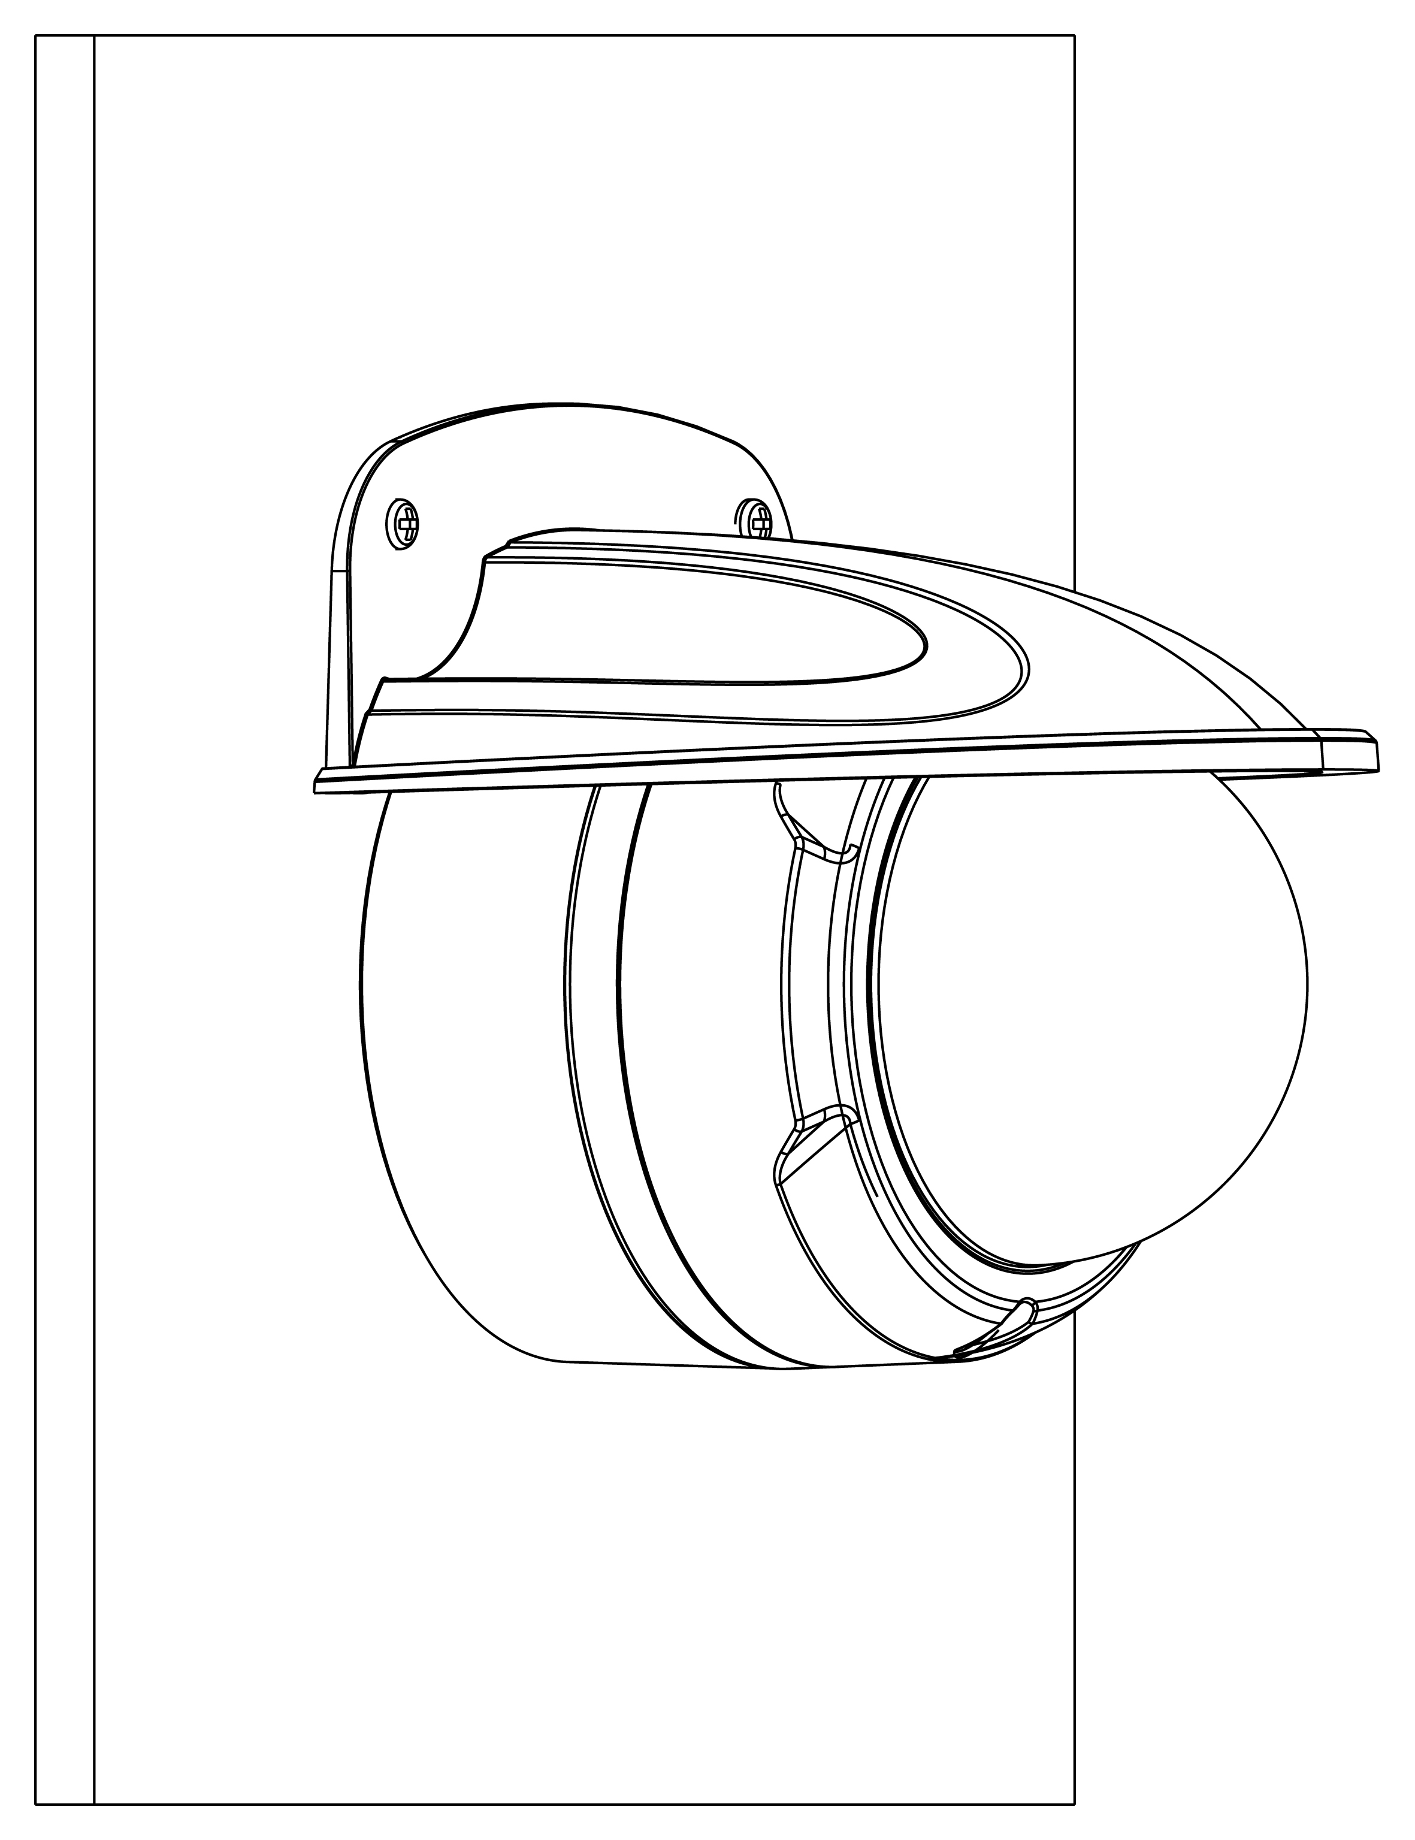
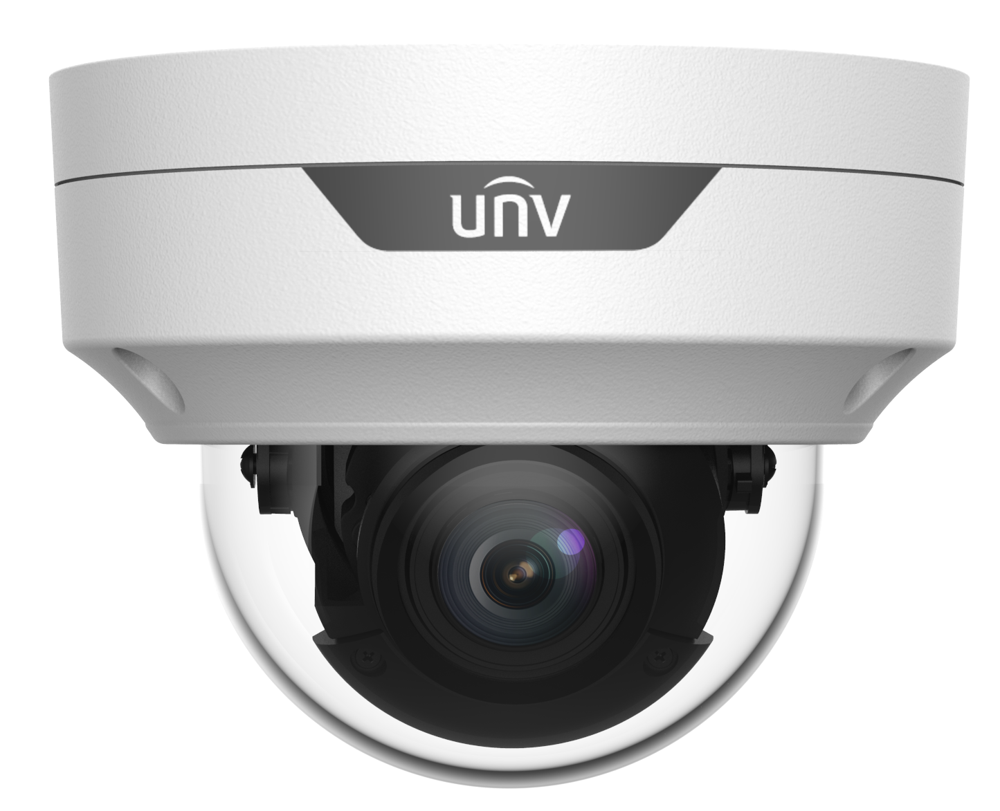
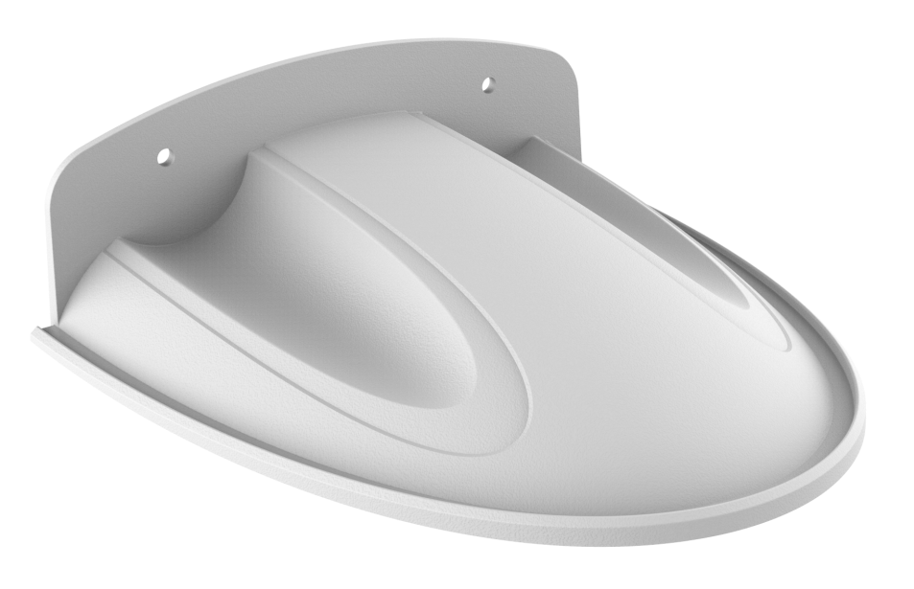
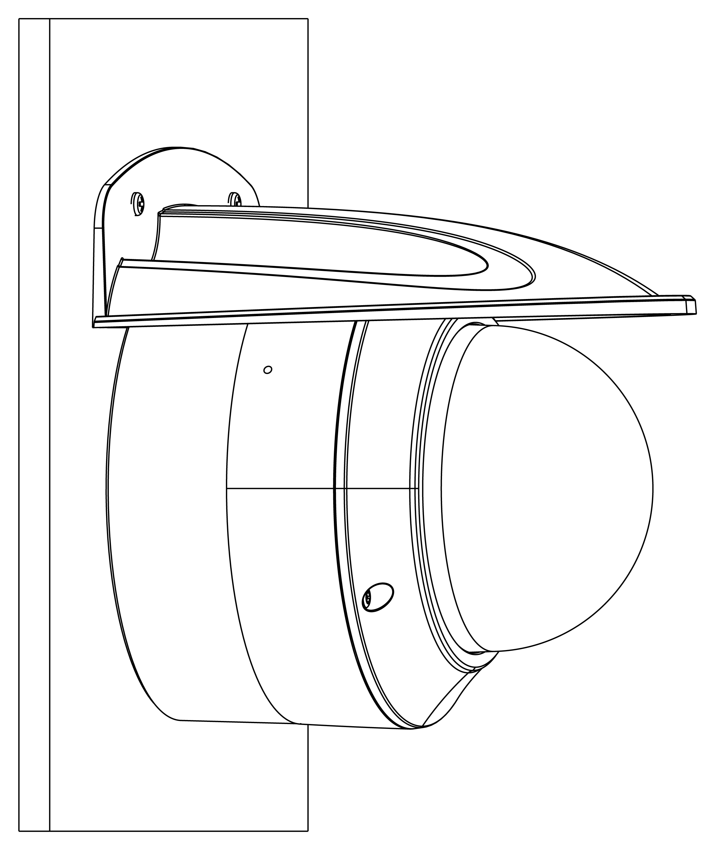
Dome camera mount
Junction box
Wall mount
IPC32X SS\SB\LB\LE series
IPC32X S/E/L series
TR-JB03-G-IN
HS-205S
Junction box
Wall mount
PRIME/EASY series
IPC353X
TR-JB03-H-IN
Mic
Junction box
Wall mount
IPC323X series
TR-JB04-C-IN
HS-207S

Slide 6
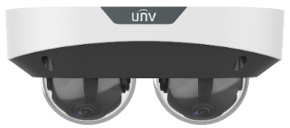
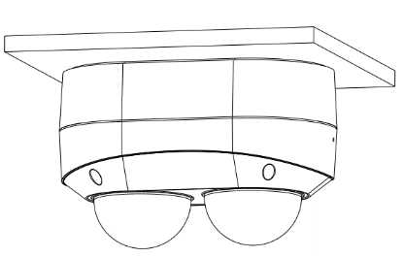
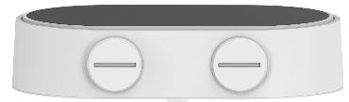
Dual-channel Dome camera mount
NPT ¾”Plastic
Waterproof joint
Junction box
（Optional）
TR-A01-IN
IPC322XSS series
TR-JB08
Notes:
2023-09-18 update：新增双通道半球交付件，全新结构，藏线盒新开，IPC3222SS-ADF28(40)K-I1/IPC3222SS-ADF28(40)K-I1，TR-JB08（2151C0LT）

Slide 7
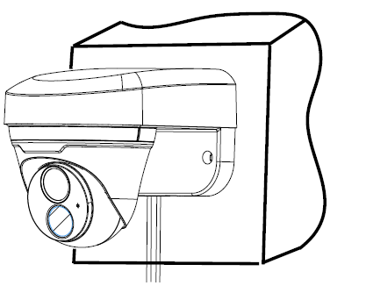
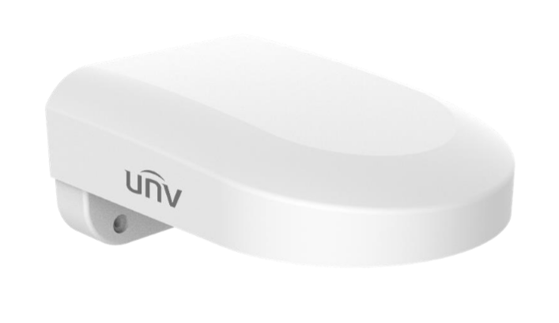
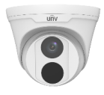
Dome camera mount
Wall mount
IPC32X SS\SB\LB\LE series
IPC32X S/E/L series
TR-WM07P-B
PRIME series
IPC361XSR -F
EASY series
IPC361XL\LE
Notes:
2018-11-15update：
藏线盒后走线孔向内增加NPS3/4管螺纹，支持安装旋塞，解决亚太客户反馈藏线盒防水问题；
壁装支架减小半径，解决北美及欧洲客户反馈段差缝隙问题；
涉及以下款型：
海螺标准款：
1、TR-JB03-H-IN 替代 TR-JB03-E-IN，计划时间：2018-12
2、TR-JB07/WM03-F-IN 替代 TR-JB07/WM03-D-IN和TR-JB07/WM03-C-IN，计划时间：2018-12
海螺L款：
1、TR-JB03-I-IN：替代TR-JB03-F-IN，计划时间：2018-12
2、TR-JB07/WM03-G-IN 替代 TR-JB07/WM03-E-IN，计划时间：2019Q1
3、TR-WM03-D-IN 替代 TR-WM03-C-IN，计划时间：2019Q1

Slide 8
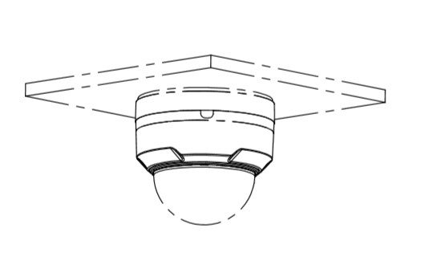
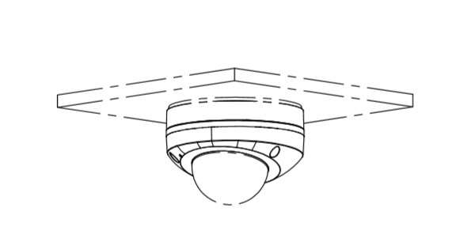
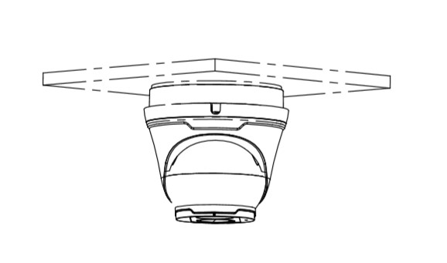
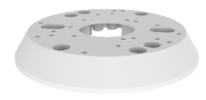
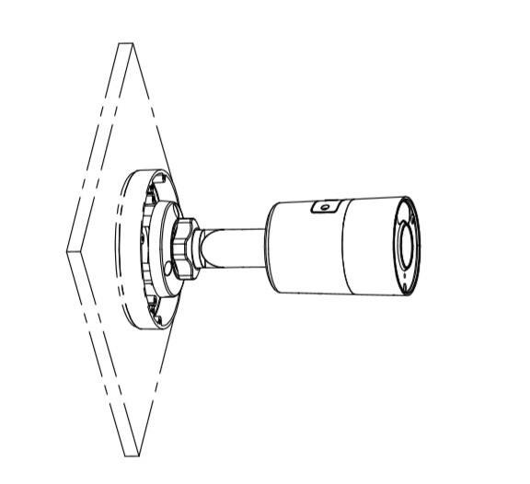
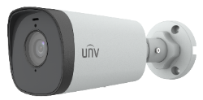
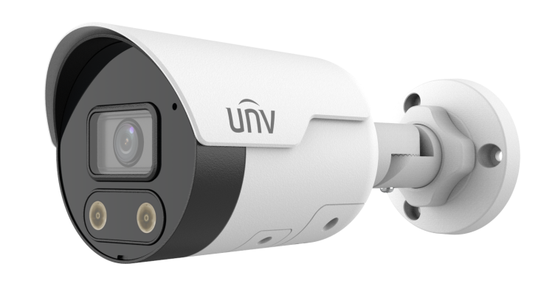







Electric-box Transfer plate
IPC32X SS\SB\LB\LE series
IPC32X S/E/L series
IPC31X
PRIME series
IPC354SR3
IPC360X SB series
Electric-box Transfer plate
PRIME series
IPC361XSR -F
EASY series
IPC361XL\LE
TR-SM05-IN
(美国NEMA-WD6标准)
IPC361X SE series
IPC3616\361X SS \361XSB series
IPC231X SB
IPC2128 SB
EASY/PRIME series
IPC21XX
IPC232X LB
IPC21XX
(Round mount)
Notes:
2023-10-19update：
1. TR-SM05-IN 替代 TR-SM03-IN（大直径满足北美客户需求）

Slide 9





Dome camera mount
Celling mount
IPC373XSE series
Corner mount
TR-UC08-C
Pole mount
TR-WM04-IN
TR-UP06-IN
Wall mount
Pendent mount adaptor is for indoor.
Outdoor installation should take care of waterproof.
TR-CM24-IN
(NPT ¾ 200mm)
Notes:
1

Slide 10

















Dome camera mount
NPT ¾”Plastic
Waterproof joint
Junction box
TR-JB03-I-IN
Optional
PRIME series
IPC361XSR -F
EASY series
IPC361XL\LE
TR-A01-IN
Wall mount
(Junction box)
Pole mount
TR-JB07/WM03-G-IN
Wall mount
TR-UP06-IN
TR-WM03-D-IN
Corner mount
TR-UC08-C
PRIME/EASY series
IPC363X
PRIME series
IPC361X S/E
Junction box
TR-JB03-H-IN
Optional
NPT ¾”Plastic
Waterproof joint
TR-A01-IN
Wall mount
(Junction box)
Pole mount
Mini PTZ series
IPC64XX
PRIME/EASY series
IPC353X
TR-JB07/WM03-F-IN
TR-UP06-IN
Wall mount
IPC363x SS\SA\SB series
IPC363x SE
series
TR-WM03-B-IN
Corner mount
TR-UC08-C
Notes:
2018-11-15update：
藏线盒后走线孔向内增加NPS3/4管螺纹，支持安装旋塞，解决亚太客户反馈藏线盒防水问题；
壁装支架减小半径，解决北美及欧洲客户反馈段差缝隙问题；
涉及以下款型：
海螺标准款：
1、TR-JB03-H-IN 替代 TR-JB03-E-IN，计划时间：2018-12
2、TR-JB07/WM03-F-IN 替代 TR-JB07/WM03-D-IN和TR-JB07/WM03-C-IN，计划时间：2018-12
海螺L款：
1、TR-JB03-I-IN：替代TR-JB03-F-IN，计划时间：2018-12
2、TR-JB07/WM03-G-IN 替代 TR-JB07/WM03-E-IN，计划时间：2019Q1
3、TR-WM03-D-IN 替代 TR-WM03-C-IN，计划时间：2019Q1

Slide 11




Fisheye camera mount
Junction box
Optional
TR-JB04-D-IN
TR-A01-IN
868 fisheye
NPT ¾”Plastic
Waterproof joint
Junction box
Optional
TR-JB03-H-IN
TR-A01-IN
814 fisheye
NPT ¾”Plastic
Waterproof joint
815 fisheye
Notes:
2018-11-15update：
藏线盒后走线孔向内增加NPS3/4管螺纹，支持安装旋塞，解决亚太客户反馈藏线盒防水问题；
涉及以下款型：
1、TR-JB04-D-IN 替代 TR-JB04-B-IN，计划时间：2018-12
2、TR-JB03-H-IN 替代 TR-JB03-E-IN，计划时间：2018-12
3、吊装方案：TR-JB04-D-IN +TR-CM24-IN（新开模具） 替代 TR-UF45-F-IN+TR-CE45-IN；计划时间：2019Q1
4、吊装方案：TR-JB03-H-IN +TR-CM24-IN（新开模具） 替代 TR-UF45-I-IN+TR-CE45-IN；计划时间：2019Q1

Slide 12




Dome camera Indoor pendent mount
*Release: 2019Q1
Junction box
IPC323X series
+
TR-JB04-C-IN
PRIME series
IPC363X
Indoor pendent mount
TR-SE24-IN
(NPT ¾ 200mm lengthen)
PRIME series
IPC361X S/E
Mini PTZ
+
TR-JB03-H-IN
Optional
PRIME series
IPC353X
Pendent mount adaptor is for indoor.
Outdoor installation should take care of waterproof.
IPC361X LB/LE
IPC361X SR -F
+
TR-JB03-I-IN
IPC32X series
TR-CM24-IN
(NPT ¾ 200mm)
IPC31X series
+
TR-JB03-G-IN
IPC354 series
IPC3616 series
IPC361X SS/SB series
868 fisheye
+
TR-JB04-D-IN
TR-SE24-A-IN
(NPT ¾ 500mm lengthen)
814 fisheye
815 fisheye
+
TR-JB03-H-IN
Optional
Dual-channel dome
+
TR-JB08
Notes:
2018-11-8update：为解决北美客户要求所有半球产品可吊装需求
新开模具：搭配新藏线盒使用
1、200mm吊杆（带吸顶盘）TR-CM24-IN ；
2、200mm加长杆TR-SE24-IN搭配CM24使用；
3、500mm加长杆TR-SE24-A-IN搭配CM24使用；
（加长杆下部为外螺纹，上部为内螺纹，理论上可无限加长）
2023-09-18update：新增双通道半球交付件，全新结构，藏线盒新开，IPC3222SS-ADF28(40)K-I1/IPC3222SS-ADF28(40)K-I1，TR-JB08（2151C0LT）

Slide 13

















Bullet camera mount
Junction box
TR-JB07-D-IN
NPT ¾”Plastic
Waterproof joint
Optional
IPC23XX series
TR-JB06-A-IN
TR-A01-IN
IPC222X series
Pole mount
Recommended side outlet for cable
IPC74X series
26X series
2AX series
TR-UP06-C-IN
Corner mount
IPC2K24SE series
TR-UC08-C
Pole mount
TR-UP06-B-IN
Notes:
2018-11-20update：
TR-JB06-A-IN暂停，重规划；
2018-11-15update：
藏线盒后走线孔向内增加NPS3/4管螺纹，支持安装旋塞，解决亚太客户反馈藏线盒防水问题；
涉及以下款型：
1、TR-JB06-A-IN：替代TR-JB07-C-IN和TR-JB07-B-IN，计划时间：2019Q1
2、TR-JB07-D-IN：替代TR-JB07-C-IN和TR-JB07-B-IN，计划时间：2018-12
3、TR-UP06-C-IN：替代TR-UP06-IN，计划时间：2019Q1

Slide 14










Bullet camera mount
Wall mount
Pole mount
IPC2C2X
TR-WM06-C-IN
TR-UP06-B-IN
Wall mount
IPC2A2X
TR-WM07P-A
Pendent mount
TR-UM06-A-IN
Pendent mount
TR-CM08P-A
Notes:
2018-11-20update：
TR-JB06-A-IN暂停，重规划；
2018-11-15update：
藏线盒后走线孔向内增加NPS3/4管螺纹，支持安装旋塞，解决亚太客户反馈藏线盒防水问题；
涉及以下款型：
1、TR-JB06-A-IN：替代TR-JB07-C-IN和TR-JB07-B-IN，计划时间：2019Q1
2、TR-JB07-D-IN：替代TR-JB07-C-IN和TR-JB07-B-IN，计划时间：2018-12
3、TR-UP06-C-IN：替代TR-UP06-IN，计划时间：2019Q1

Slide 15




Bullet camera mount
Junction box
NPT ¾”Plastic
Waterproof joint
Optional
IPC252 series
IPC254 series
TR-JB07-D-IN
TR-A01-IN
Pole mount
TR-UP06-C-IN
Corner mount
Recommended side outlet for cable
TR-UC08-C
Pole mount
TR-UP06-B-IN

Slide 16
Bullet camera mount
Wall mount
Pole mount
IPC2C2X
TR-WM06-C-IN
TR-UP06-B-IN
Pendent mount
IPC2A2X
TR-UM06-A-IN
Notes:
2018-11-20update：
TR-JB06-A-IN暂停，重规划；
2018-11-15update：
藏线盒后走线孔向内增加NPS3/4管螺纹，支持安装旋塞，解决亚太客户反馈藏线盒防水问题；
涉及以下款型：
1、TR-JB06-A-IN：替代TR-JB07-C-IN和TR-JB07-B-IN，计划时间：2019Q1
2、TR-JB07-D-IN：替代TR-JB07-C-IN和TR-JB07-B-IN，计划时间：2018-12
3、TR-UP06-C-IN：替代TR-UP06-IN，计划时间：2019Q1

Slide 17







Mini Bullet camera mount
Pole mount
TR-UP06-B-IN
EASY/PRIME series
IPC21XX
Pole mount
Junction box
TR-JB05-A-IN
TR-UP06-C-IN
IPC231X SB
IPC2128 SB
NPT ¾”Plastic
Waterproof joint
Junction box
TR-A01-IN
IPC232X LB
IPC21XX
(Round mount)
TR-JB05-B-IN
(Round)
Optional
Corner mount
IPC231X LE
TR-UC08-C
Notes:
2018-11-15update：
藏线盒后走线孔向内增加NPS3/4管螺纹，支持安装旋塞，解决亚太客户反馈藏线盒防水问题；
新增圆形藏线盒解决北美客户圆形酒杯不协调问题；
涉及以下款型：
1、TR-JB05-A-IN 替代 TR-JB05-IN，后走线孔向内增加NPS3/4管螺纹，计划时间：2018-12
2、新增圆形TR-JB05-B-IN，计划时间：2019Q1
3、新增TR-UP06-C-IN，计划时间：2019Q1

Slide 18







Bullet camera mount
Wall mount
IPC262EB-HDX10K-I0
Pendent mount
2A2XSE series
Pole mount
Pole mount
TR-UP06-C-IN
Recommended side outlet for cable
TIC2621SR-F3-4F4AC-VD
Corner mount
TR-UC08-C

Slide 19







Positioning system mount
Junction box
Corner mount
TR-JB07-D-IN
TR-UC08-C
NPT ¾”Plastic
Waterproof joint
Optional
IPC672 Series
TR-A01-IN
Pole mount
Pole mount
Recommended side outlet for cable
IPC6312 Series
TR-UP06-B-IN
TR-UP06-C-IN
Pendent mount
IPC675 Series
TR-CM06-D

Slide 20


















PTZ camera mount
Pendent mount adaptor
(support side cabling)
Pendent mount adaptor is for indoor.
Outdoor installation should take care of waterproof.
TR-UF45-A-IN
Pendent mount (500mm)
Pendent mount adaptor
(support side cabling)
Pendent mount (200mm)
TR-SE45-A-IN
TR-UF45-A-IN
TR-SE45-IN
Pendent mount (200mm)
(support side cabling)
IPC62xx Series
IPC63xx Series
IPC66xx Series
TR-CE45-IN
Wall mount
(Shorter bracket)
Pole mount
TR-WE45-IN
Steel：TR-UP08-A-IN
Al Alloy：TR-UP08-B-IN
IPC6424SR-X25-VF
Wall mount
(Longer bracket)
TR-JB12-IN
Corner mount
TR-WE45-A-IN
Steel ：TR-UC08-A-IN
Al Alloy ： TR-UC08-B-IN
Wall mount
(Swan neck bracket)
TR-WE45-B-IN

Slide 21







PTZ camera mount
Pendent mount adaptor
(support side cabling)
Pendent mount adaptor is for indoor.
Outdoor installation should take care of waterproof.
Pendent mount (500mm)
TR-UF45-A-IN
Pendent mount adaptor
(support side cabling)
IPC94144 Series
Pendent mount (200mm)
TR-SE45-A-IN
TR-UF45-A-IN
TR-SE45-IN
Pendent mount (200mm)
(support side cabling)
TR-CE45-IN
Wall mount
(Shorter bracket)
Pole mount
TR-WE45-IN
Steel：TR-UP08-A-IN
Al Alloy：TR-UP08-B-IN
Wall mount
(Longer bracket)
TR-JB12-IN
Corner mount
TR-WE45-A-IN
Steel ：TR-UC08-A-IN
Al Alloy ： TR-UC08-B-IN
Wall mount
(Swan neck bracket)
Wall mount
TR-WE45-B-IN

Slide 22













PTZ camera mount
Pendent mount adaptor
(support side cabling)
Pendent mount adaptor is for indoor.
Outdoor installation should take care of waterproof.
TR-UF45-A-IN
Pendent mount (500mm)
Pendent mount adaptor
(support side cabling)
IPC68xx Series /TIC6831ER-F50-4X38P
Pendent mount (200mm)
TR-SE45-A-IN
TR-UF45-A-IN
TR-SE45-IN
Pendent mount (200mm)
(support side cabling)
TR-CE45-IN
Pole mount
Steel：TR-UP08-A-IN
Al Alloy：TR-UP08-B-IN
TR-JB12-IN
Wall mount
(Longer bracket)
Corner mount
TR-WE45-A-IN
Steel ：TR-UC08-A-IN
Al Alloy ： TR-UC08-B-IN
Wall mount
(Swan neck bracket)
TR-WE45-B-IN

Slide 23












Indoor PTZ camera mount
In-ceiling mount
TR-FM200-IN
Shorter bracket
Indoor wall mount
TR-WE45-IN
Longer bracket
TR-WE45-A-IN
IPC6222EI Series
Adaptor
Swan neck bracket
TR-UF45-H-IN
TR-WE45-B-IN
Indoor pendent mount
TR-CE45-IN
Pendent mount (500mm)
Indoor pendent mount
TR-SE45-A-IN
Pendent mount (200mm)
TR-CE45-IN
TR-SE45-IN

Slide 24










Indoor PTZ camera mount
Junction Box
(Optional)
TR-WE45-D-IN
TR-JB07-D-IN
Pendent mount
TR-CM06-C-IN
IPC8542ER5-DUG/P
2D Bracket Mount
Pole mount
TR-UV06-C-IN
TR-UP06-IN
Wall Mount
Pole mount Adapter
TR-WE45-D-IN
TR-UP06-B-IN

Slide 25




Omniview Network Camera + PTZ dome mount
Omniview Network Camera
+
PTZ dome
wall mount
TR-WE45-E-IN
pole mount
KIT-TR4-1

Slide 26






Positioning system mount
IPC76xx Series
wall mount
2115C08G
Pedestal installation
No accessory
It is necessary to ensure that the mounting base is firm enough

